Slide 1
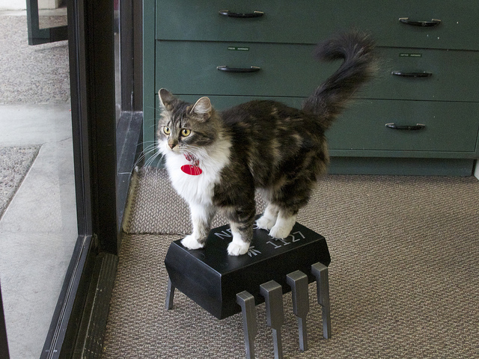
Hardware as Code
Automate Everything

Slide 2
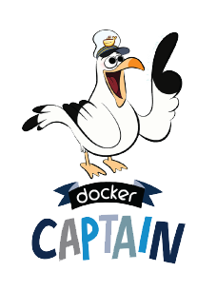
Hi I’m Tim
“Docker Captain” – Community Leader
PHP JHB Organiser
17 Years Development and DevOps
tim@haak.co

Slide 3

Quick Survey
Primary laptop/desktop OS?
Primary server OS?
Who has set up a server?
Who finds setting up servers fun?

Slide 4
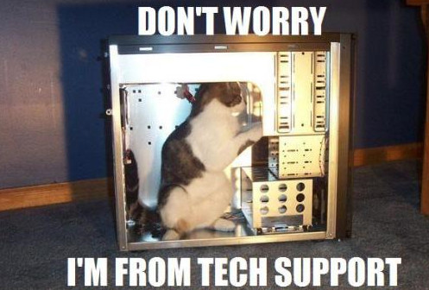
First, what are the problems?

Slide 5
How long…
Provision a new server?
Rebuild all the pieces for a service?
Work out what is on a server?
Rollout updates to everything?
Roll back a service or server?

Slide 6

Problem 1: Speed
Setting up servers by hand can take quite a while.
Deploying new services
Slow by hand
Error prone
Takes to long to set up a clean server to quickly test something

Slide 7
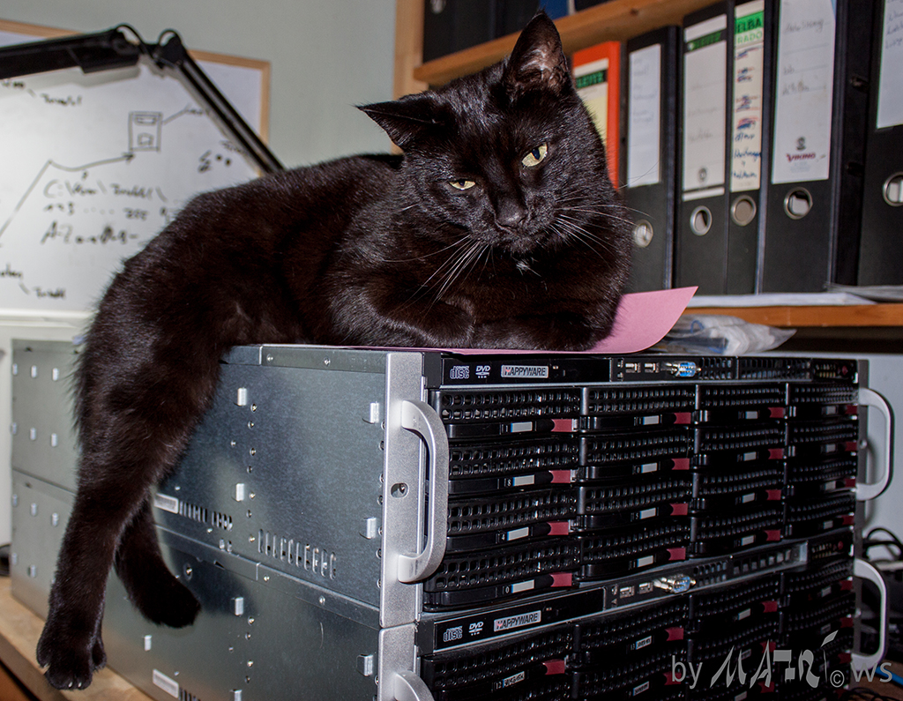
Problem 2: What’s really on the server?
Human memory problems
What was on this server again?
Is live, staging, and testing the same?
But it worked on the developers/my PC!

Slide 8
Problem 2: What’s really on the server?
Bob’s sick, how did he set this up?
How do I bring new people on? (Documentation)
We are error prone
PC’s only ever do what we tell them.

Slide 9

Problem 3: What Changed?
What was changed?
When was it changed?
Can I prove either of these?

Slide 10

Problem 4: Repeatability
I’m not always sure when I roll out that it will work
So let’s not do it often

Slide 11

Bad patterns
Cowboy/Cowgirl style
Just do it! We’ll worry when it breaks…
I don’t test, but when I do I do it on live!

Slide 12
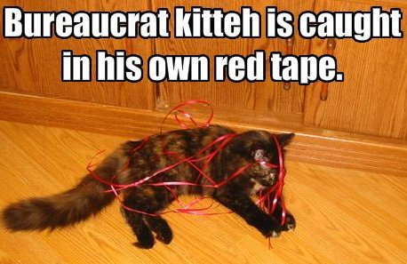
Bad patterns
Bureaucrat style
If it’s breaking, it means we don’t have enough documentation/processes.
We can’t roll out the critical patch to fix the broken thing as change control only meets next week. (True story)

Slide 13

Better patterns to solve these
Automation
Automate all the things!!!
Have tools that everyone in the team can use
But you know are safe and tested.
Have an option to easily roll back.
Blue/Green deployments.
Add web based frontends to these
DevOps don’t just tell people to run a script.
Dev you have to help write the frontend to run the script.

Slide 14
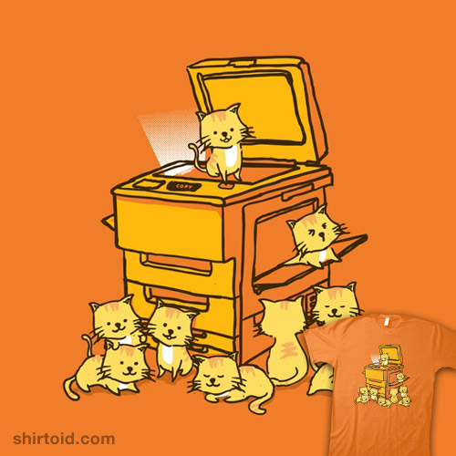
Better patterns to solve these
Immutability where we can
An immutable object is an object whose state cannot be modified after it is created

Slide 15
But how do we do this?

Slide 16
But how do we do this?
On the server, hardware and operating system side
Hardware/Infrastructure as code
Describe layout in text files that are committed to version control systems
Continuous Integration (CI)
Automated testing
Automated building

Slide 17
But how do we do this?
On the code side
Code is text that you commit to version control systems
Continuous Integration (CI)
Automated testing
Automated building

Slide 18
These look strangely similar
On the server, hardware and operating system side
Hardware/Infrastructure as code
Describe layout in text files that are committed to version control systems
Continuous Integration (CI)
Automated testing
Automated building
On the code side
Code is text that you commit to version controll systems
Continuous Integration (CI)
Automated testing
Automated building

Slide 19

How do we do this practically?

Slide 20
Step 1:Definition Files

Slide 21
Use Definition Files
All configuration is defined in executable configuration definition files, such as shell scripts, Ansible, SaltStack, Chef, or Puppet.
Personal preference is Ansible as it’s simpler to get started.
Commit scripts to your version control.

Slide 22
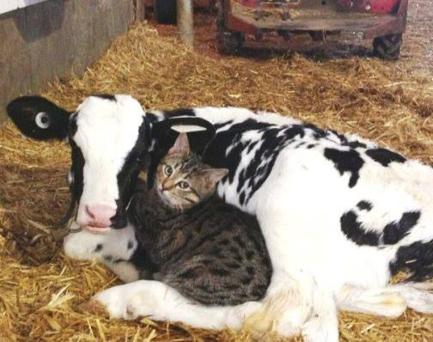
Cattle not pets
Servers should be treated as cattle not pets!

Slide 23

Stop doing things by hand
At no time should anyone log into a server and make on-the-fly adjustments.
Any time you do this you risk turning your server into a pet.

Slide 24

Bonus outcome: Documentation
You’ve just documented what is on your server.
If you need it in a more human format it can be generated from the code.
Unlike a document a human would follow and run by hand, you can guarantee that it was done exactly as set in the code.

Slide 25

Version All The Things!!!
Keep this code in version control.
Changes can now be audited.
Something breaking on live?
Just use the script to build a test server.

Slide 26
Continuous Deployment and Testing
Now that you have it as code you can use all the normal code tooling to run and test.

Slide 27
Run It Often
The smaller the change the lower the risk.
Fewer things to keep in your head.
Ensure that your servers are always in a know state (Immutable).
The more often you do something…The more predictable it gets.
Doing things more often actually decreases risk.

Slide 28

Step 2: Build The Whole Server

Slide 29
Use Definition Files for Everything!
Stop doing the initial operating system install by hand.
Here I use Packer.
Handles most cloud providers and virtual servers.
Produces images to your specification.
Doesn’t do bare metal ☹
Look at
https://github.com/google/netboot
https://github.com/jpetazzo/pxe
http://cobbler.github.io/
https://theforeman.org/

Slide 30

Packer
Very simple config file.
Can use most provisioning systems.
Ansible, Puppet, Windows Shell, PowerShell, etc…
Use the definition files you’ve already created.
Gives you the true guarantee that no human has touched the image and everything done to the server is documented.

Slide 31

Step 3: Automate System Deployment
You know have all the pieces for your server versioned and building.
The next step is to automate their deployment and setting up things like networking.
Most virtualisation has API’s to do this.
My preferred tool for this is Terraform (Done by the same company as packer)

Slide 32
Terraform
Terraform is a tool for building, changing, and versioning infrastructure safely and efficiently.
Terraform can manage existing and popular service providers as well as custom in-house solutions.

Slide 33
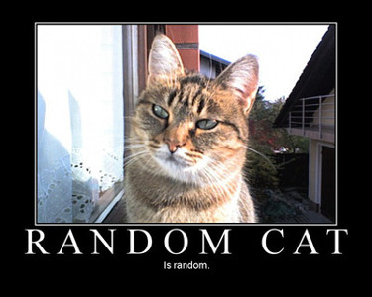
Terraform
Description of infrastructure done via Text files.
There’s a pattern there ☺
When you make a change it will work out the difference between what was done previously and current change.
Can get it to return planned changes.

Slide 34
Terraform
Can set up pretty much your entire infrastructure.
Networking
DNS
Servers
etc…

Slide 35
Terraform
Outputs from one section can be used in a second.
i.e. IP’s from servers it’s setup can be used to create DNS entries later.
This was one of the simplest new technologies I’ve learnt recently.
Had something up and working in about 2 hours. (Starting from no knowledge).

Slide 36
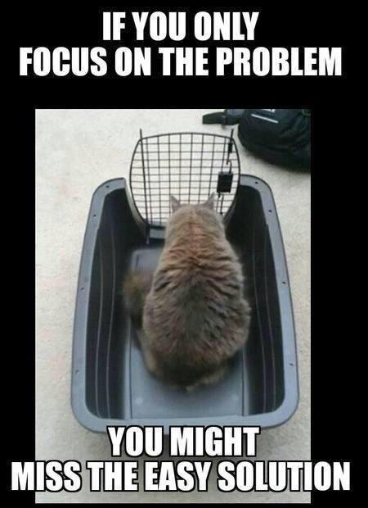
Step 4: Containerize Your Applications
This area is still a work in progress.
Docker seems to be the winner.
More so in the Linux world than Windows.
Though you now have Windows native containers as well.
Microsoft working with Docker quiet closely on this.

Slide 37
Container Advantages
Immutability .
Images versioned.
Removes the “but it worked on my pc”.
No more difference between dev, testing, and prod.
Within reason i.e. DB
Can be shared easily.
Built off of text files (Dockerfiles).

Slide 38
Container Advantages
Lower cost than virtualization.
Base systems need fewer things installed which increases it’s security.
Allows splitting pieces up making it easier to update single piece.
Simpler to test.
Simpler roll back.
Within reason i.e. DB

Slide 39

What things aren’t dealt with?
Things that mutate:
Assets
Database
etc…
Problems that already exist on the stack.

Slide 40
Data Not With Server
Try to not keep the data with the server.
Store images on NAS, GridFS, Ceph, etc…
When running in a cloud, use the provider’s blob storage and similar storage.
Relational DB’s are a special case as you want them as close to the metal as possible.

Slide 41

My Current Pattern

Slide 42
My Current Pattern
Image build with packer.
Docker installed and setup.
Terraform for setup.
This depends on client and complexity.
Docker Machine for key generation and Docker setup.
Allows controlling Docker remotely with shared SSL keys.
Docker for all services running on servers.
Allows me to replicate entire stack locally when developing.

Slide 43
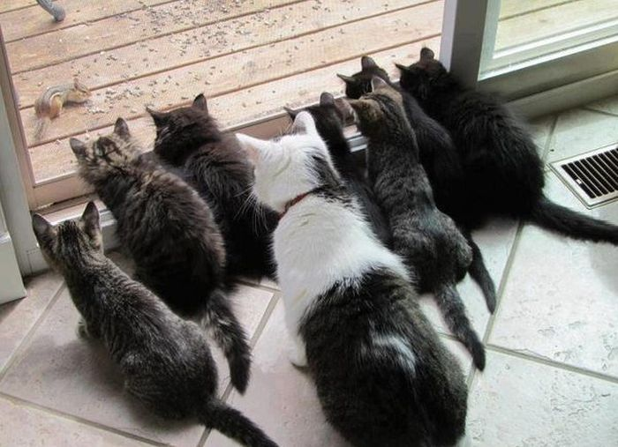
Some Interesting Things To Look At

Slide 44

Chaos Monkey
Developed by Netflix.
Will randomly turn off services and servers.
How sure are you about your failover and high availability.
If you don’t test you don’t know.

Slide 45


Consul, etcd, etc.
Distributed fault tolerant DB.
Aimed at storing config.
Not built to be a database but as a way to store config and system state.
Tooling to generate configs:
https://github.com/hashicorp/consul-template
https://www.hashicorp.com/blog/introducing-consul-template/

Slide 46

Vault
Hashicorp, again…
Centrally secure, store, and tightly control access to secrets across distributed infrastructure and applications.

Slide 47

Rundeck
Webased workflow and job scheduler.
Can run things like Ansible etc…
Centralized.
Simple way for DevOps to provide GUI to Developers.
http://rundeck.org/

Slide 48

Questions?

Slide 49

Thanks

